Slide 1
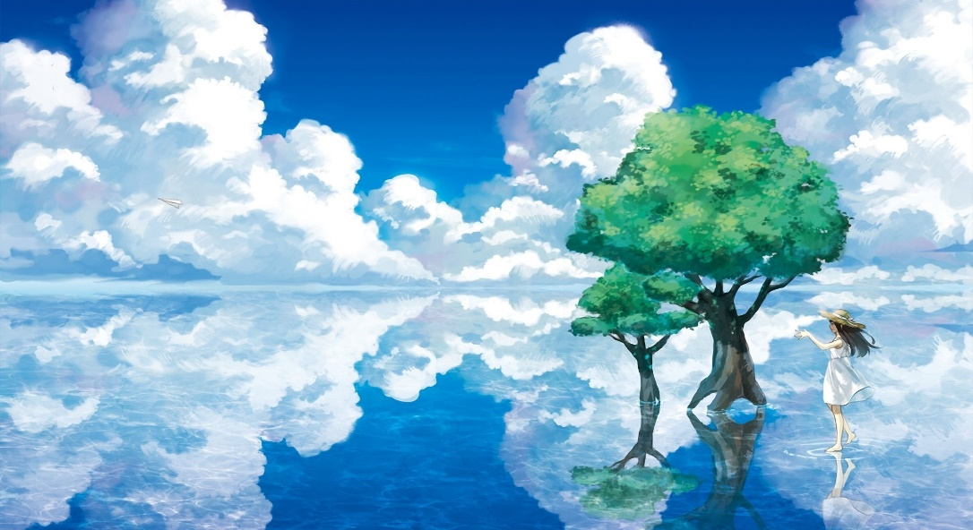
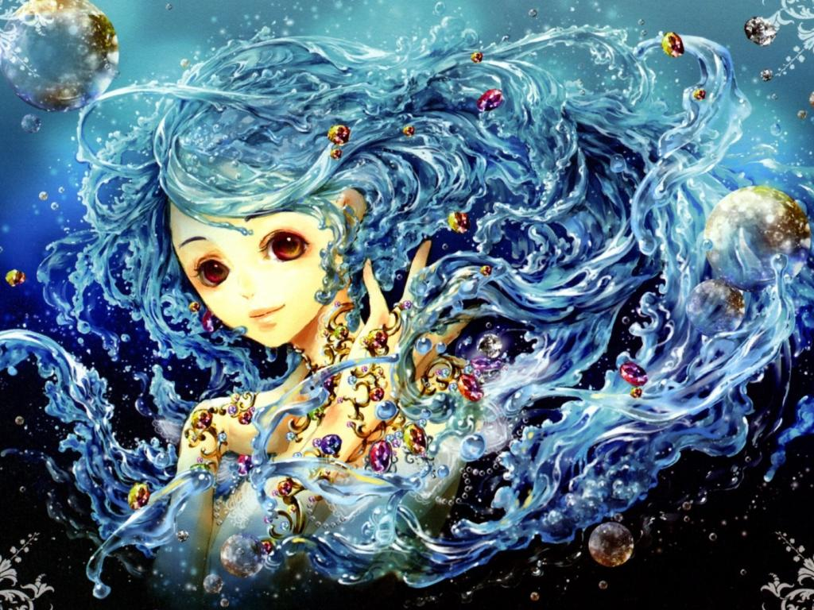
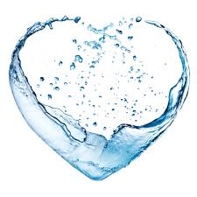
Water is life
By: Jennifer Furr
An Art unit for 4th – 5th grade
elementary students
By: Jennifer Furr

Slide 2
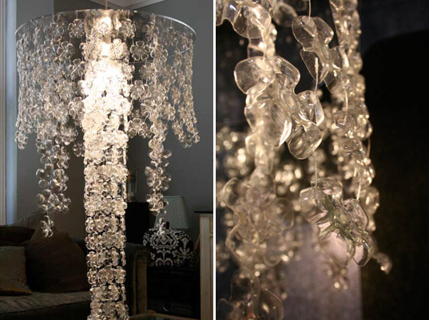
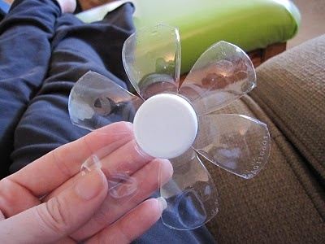
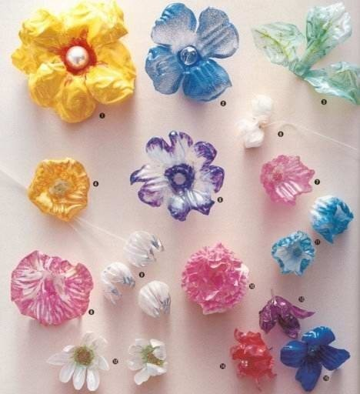
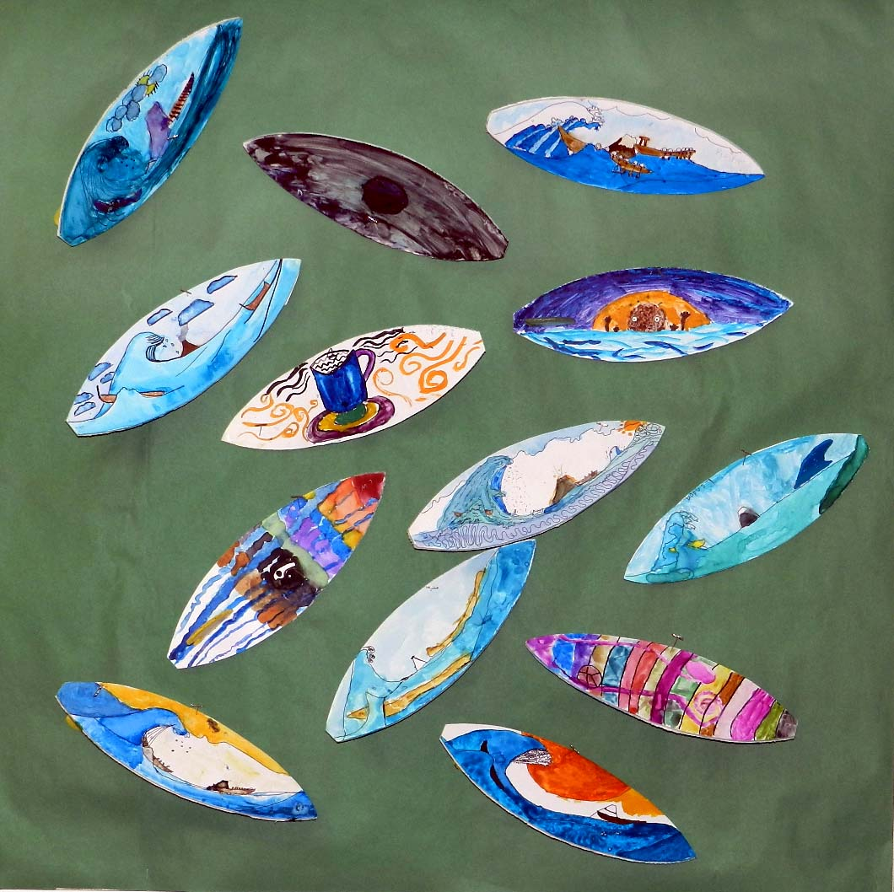
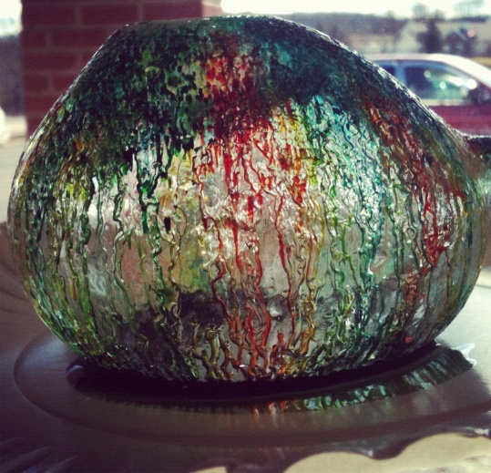
Essential Questions: *How much do we use water in art and would we even be able to create art without the use of water? *How has water influenced the subject matter of paintings and other art forms? *Could life exist without water? *How can we show the importance of water in our everyday lives through the art we create? Students will be able to: *Understand that life depends on water *Understand that water influences art making * Demonstrate empathy for the environment and for one another.
Lesson 1 – Water bottle art
Lesson 2 – Surfing the Great Wave
Lesson 3- Sculpting with
Water

Slide 3
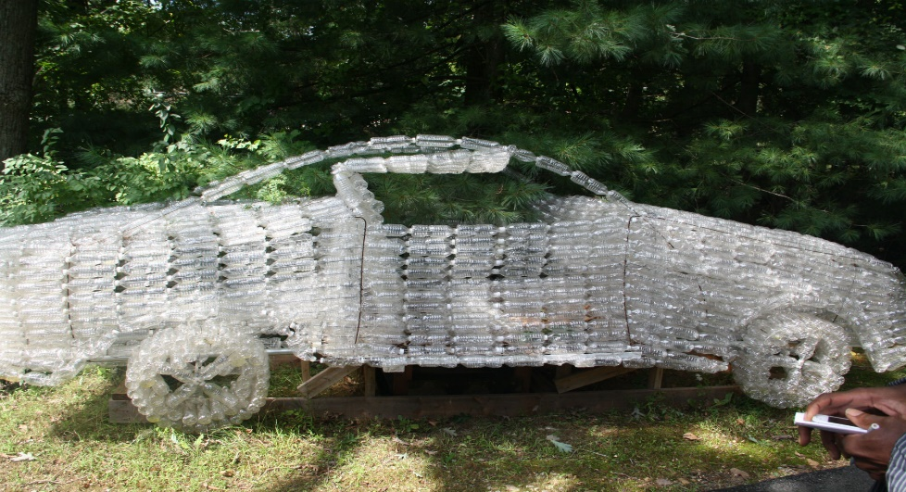
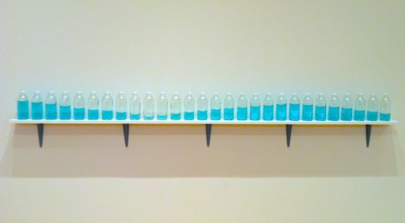
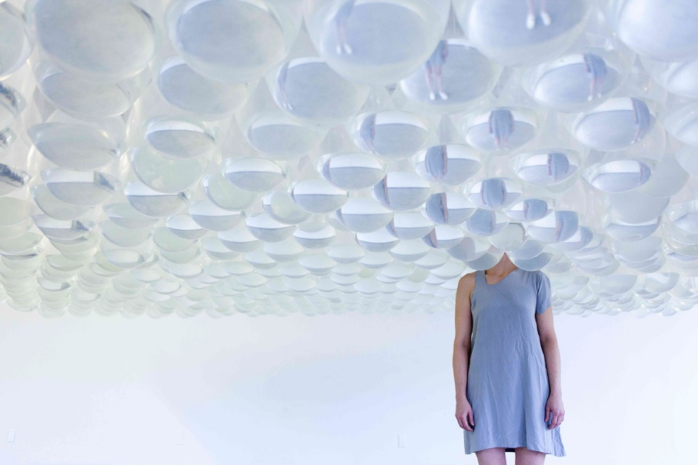
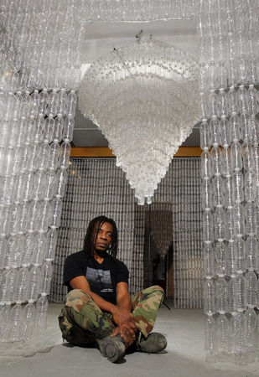
Lesson 1: From Water Bottles to Chandeliers
Tony Feher
Willie Pope
Cheryl Pope

Slide 4
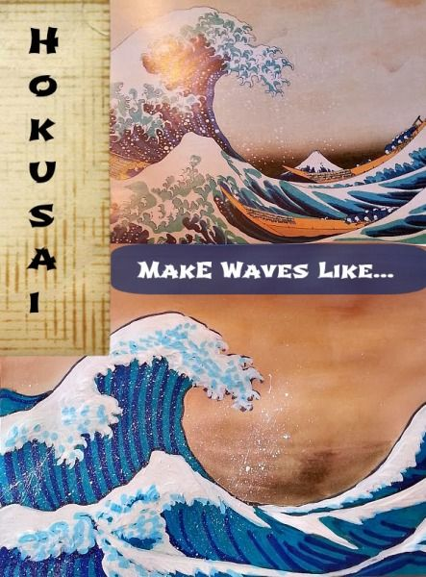
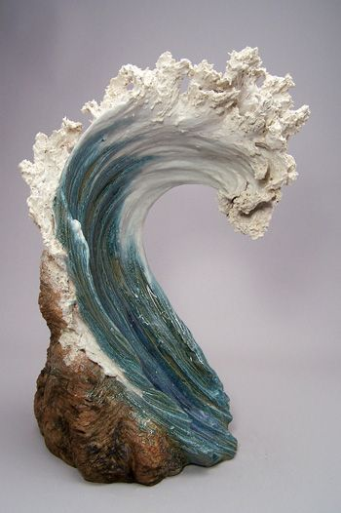
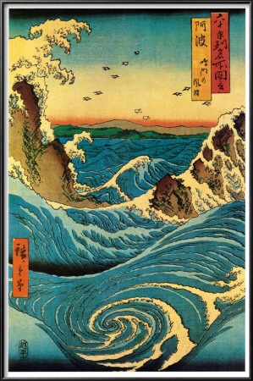
Lesson 2: Surfing the great wave
Hokusai
Denise
Romecki
Hiroshige

Slide 5
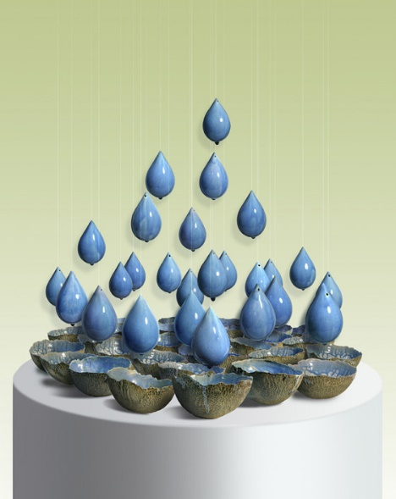
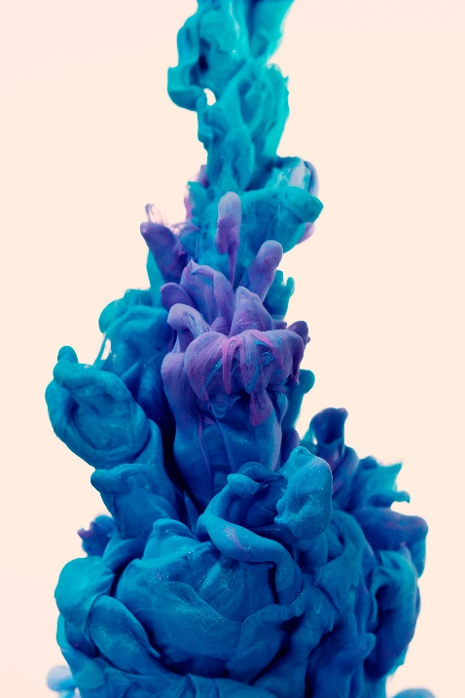
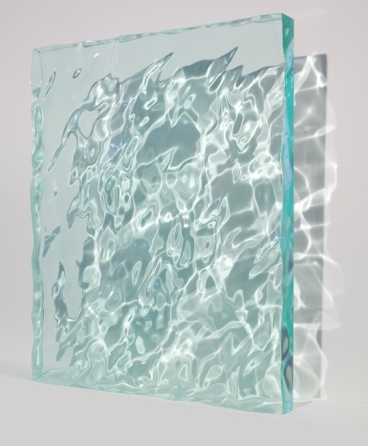
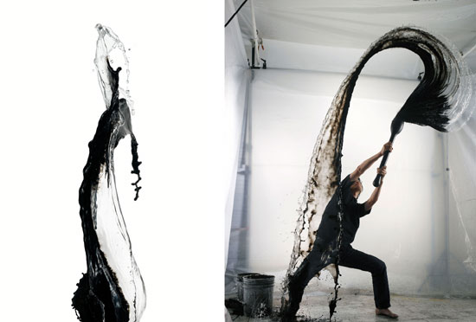
Lesson 3: Sculpting with water
Naoko Okabe
Alberto Seveso
Shinichi Maruyama
Sophia Collier

